Slide 1
Russian speaking STEM class
CPA STEM For Families, International group
Group lead – Lena Smirnova
yelenas@caltech.edu
Group coordinator –Liza Bradulina
liza.bradulina@gmail.com
Regular meeting place- Caltech Y

Slide 2
Who are we?
Families that affiliated with Caltech and JPL
Families outside Caltech and JPL invited by the lead teacher
Families with shared interest in STEM class taught in Russian

Slide 3
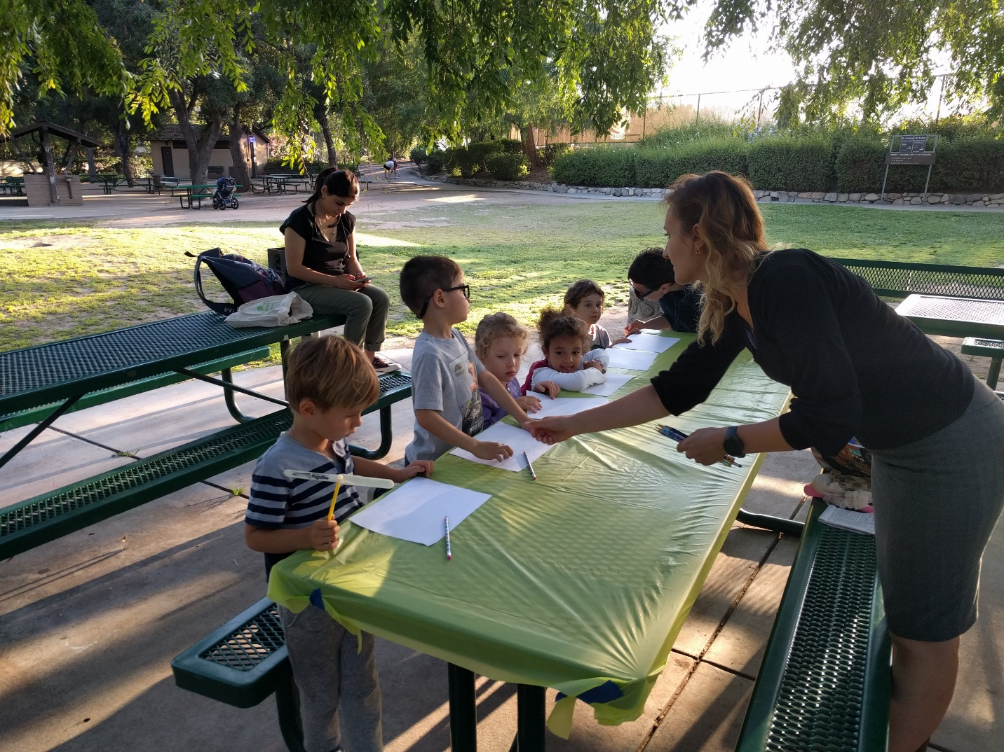
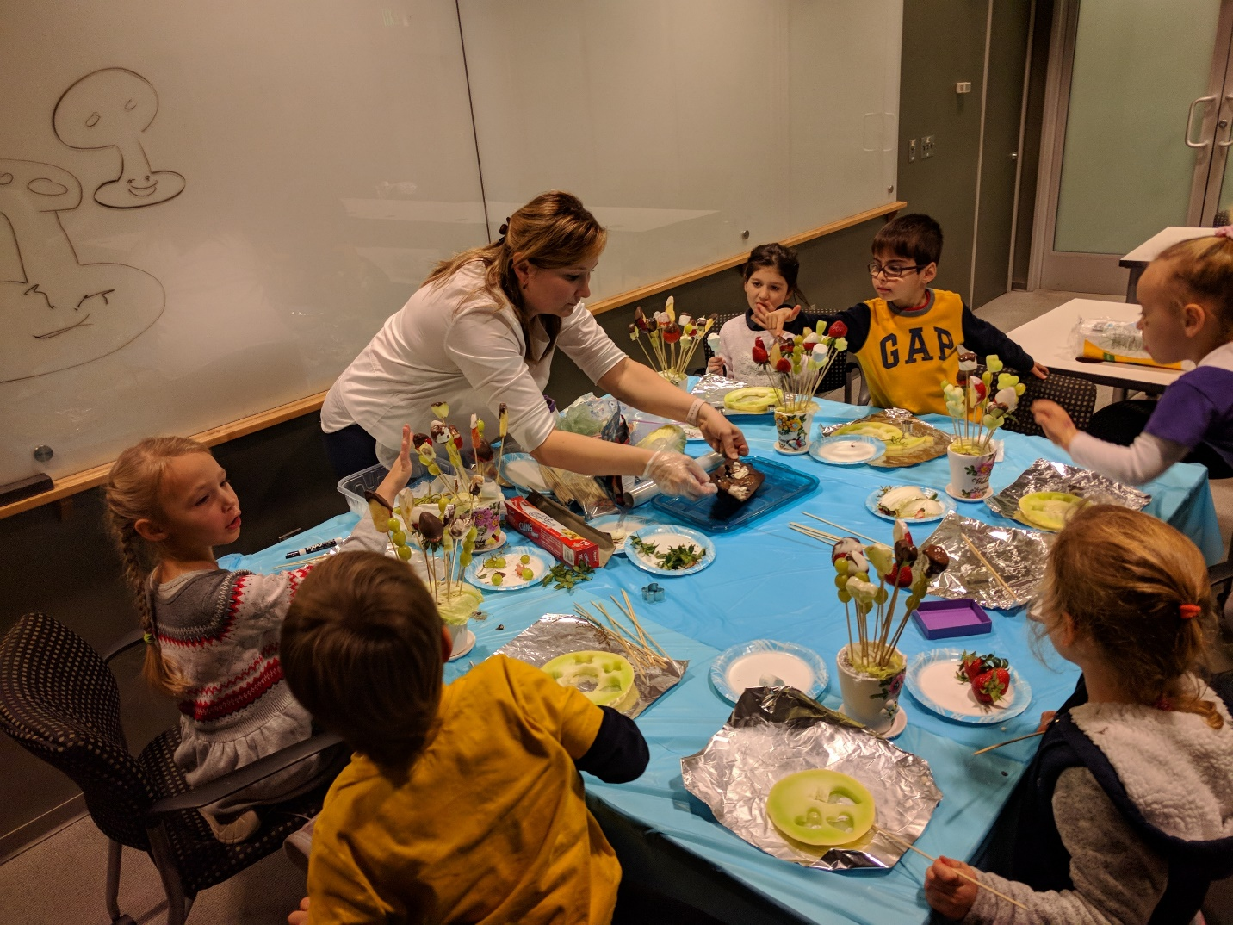
Who are our students?
Children who have recently come to the US from other countries with Russian as their native language
Children who live in the US but speak Russian at home
Children who have only one Russian speaking parent

Slide 4
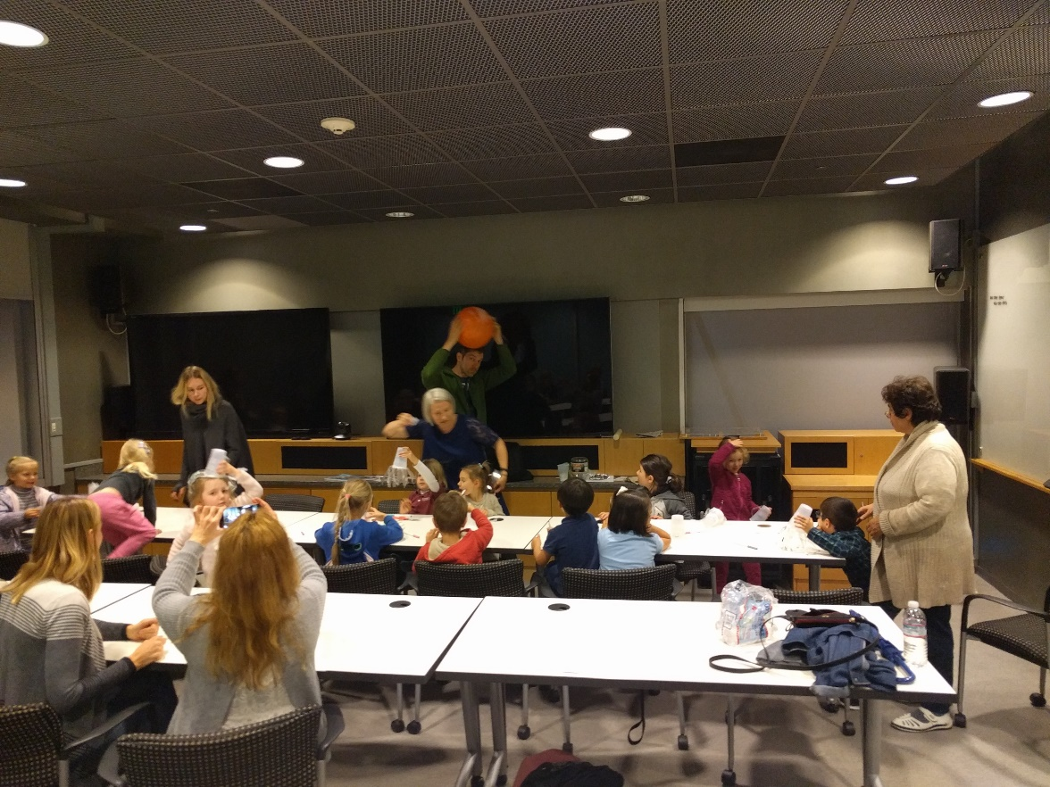
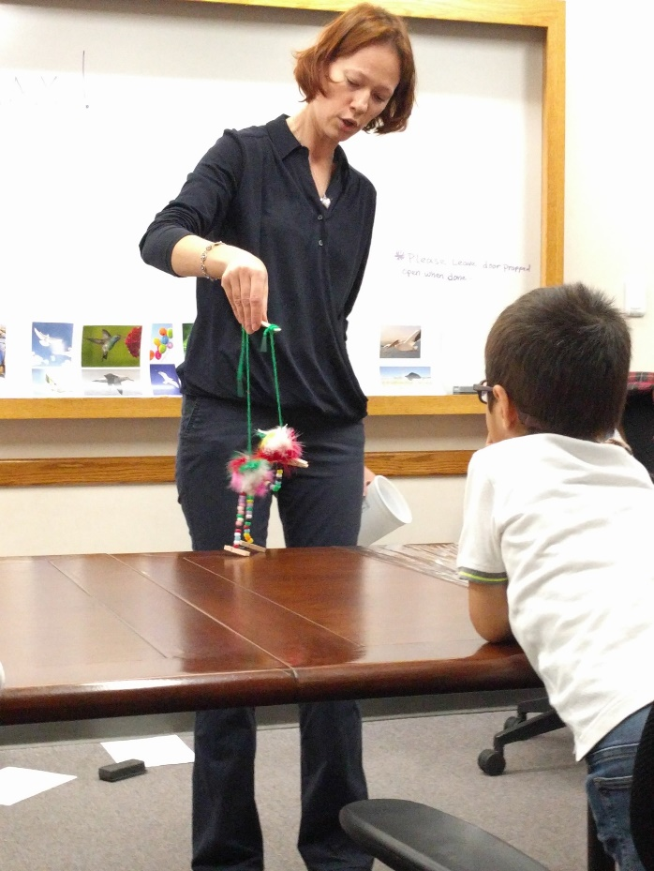
Why are we doing this?
Children do not forget their native language
They continue developing their social,emotional, and cognitive skills regardless their fluency in English
Increase their Russian vocabulary
Outreach to local communities who also speak Russian

Slide 5
Would you like to join or start your own group?
The group has open spaces for a few new families
We will be happy to share our experience with other international groups to help them start
Thank you for your support, CPA STEM For Families!

Slide 6
Thank you for your attention! Спасибо за внимание!

